Slide 1

AUGMENTED REALITY TECHNIQUES FOR MEASUREMENT AND DESIGN THOBE AND DRESS
1. Name Aechah Chesani
2. Name Sainab Doni

Slide 2
INTRODUCTION
Clothing or attire It is necessary that human must wear. To protect the body from the weather, the environment, safety, and to reflect the social and cultural. Dresses are one-piece clothes for women, that is popular with women of all ages can wear and use for different occasions. Thobe is a kind of Muslim costume for men It is an honorable costume that is popular to wear on important days in Islam such as Eid, wedding and etc.

Slide 3
PROBLEM STATEMENT
Most dressmakers use paper in handwriting design. Some dressmakers are unable to write or draw designs that make customers clearly visible. Or sometimes the concept of a tailor and the customer is different.
Order products online such as Lazada Shopee or Live via Facebook. When receiving the product, feel dissatisfied

Slide 4
OBJECTIVE
To develop measurement and designing application by using augment reality techniques.
To simulate real clothing for fitting the perfect form for customers.

Slide 5
PROJECT SCOPE
Measurement and designing dress application will develop for gentleman and ladies customer. This application will ability in measure the size of his body, customers able to design dress style by them salve, which include arm, cover, the bag, of dress.

Slide 6
SIGNIFICANT OF STUDY
This project has benefits both to developer and user. For developers, they can learn how to create application, learn and use new programs such as unity3D, improve themselves in programing and graphic skill and they can apply to create apps with various things. For users, they can use this application for measure and design their dress. They no need to dress and out of home for go to the tailor shop, they just use this application on their smartphone or tablet.

Slide 7
TOOLS USED
- Adobe Illustrator
Use to create and edit the pictures which are use in application.
- Unity3d
Use to create the various function in application.
Use to show the information on screen.
Use to make augmented reality for sample the thobe.

Slide 8
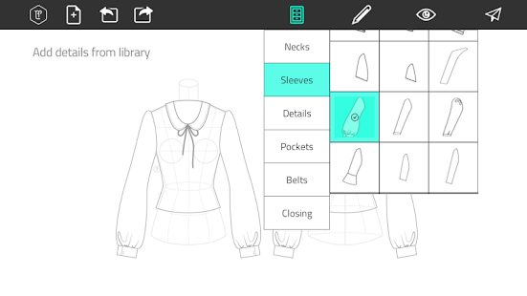
CHAPTER 2 LITERATURE REVIEW

Slide 9
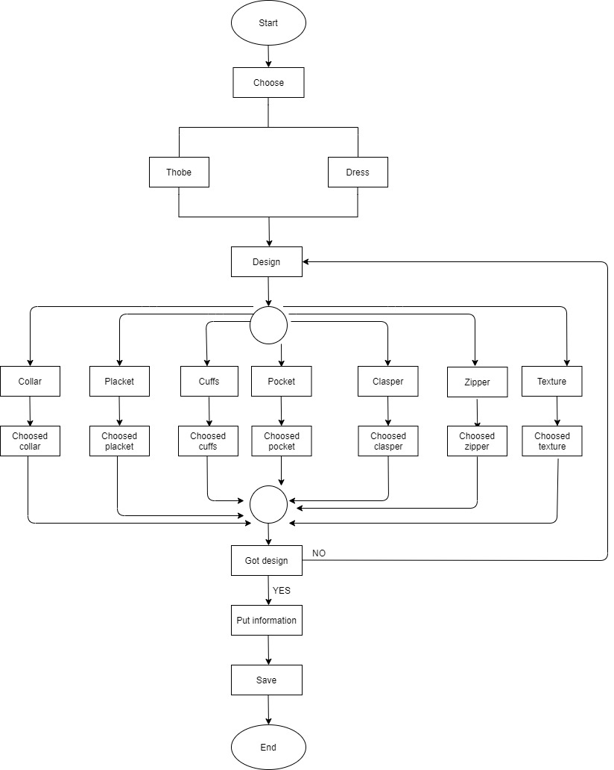
CHAPTER 3 METHODOLOGY

